Slide 1
From Bytes to Bites: Predicting Zomato Restaurant Success
By
Sritoma Koyal

Slide 2

Zomato in Bangalore
Huge Market Presence
Significant Consumer Influence
Business Impact

Slide 3

Project Purpose and Scope
Purpose - Analyzing Bangalore’s Gastronomic Landscape Through Data
Project Scope
A Data-Driven Approach to Culinary Excellence
Data Collection
Exploratory Data Analysis (EDA)
Predictive Modeling
Validation & Application

Slide 4
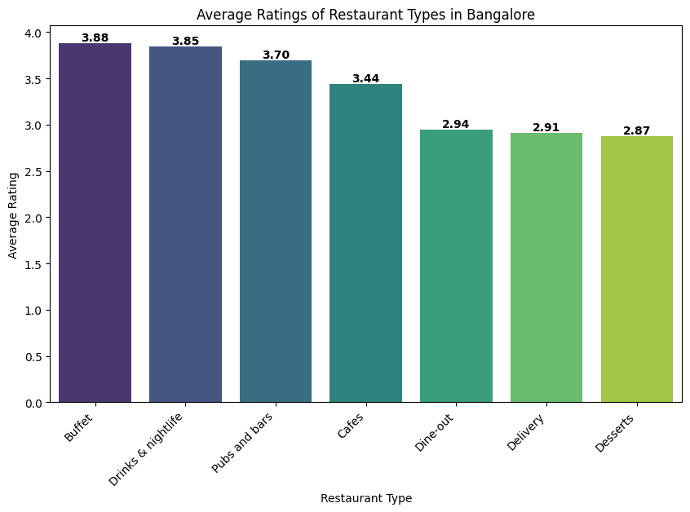
Key Determinants of Restaurant Success
What are the most liked restaurant types in Bangalore?

Slide 5
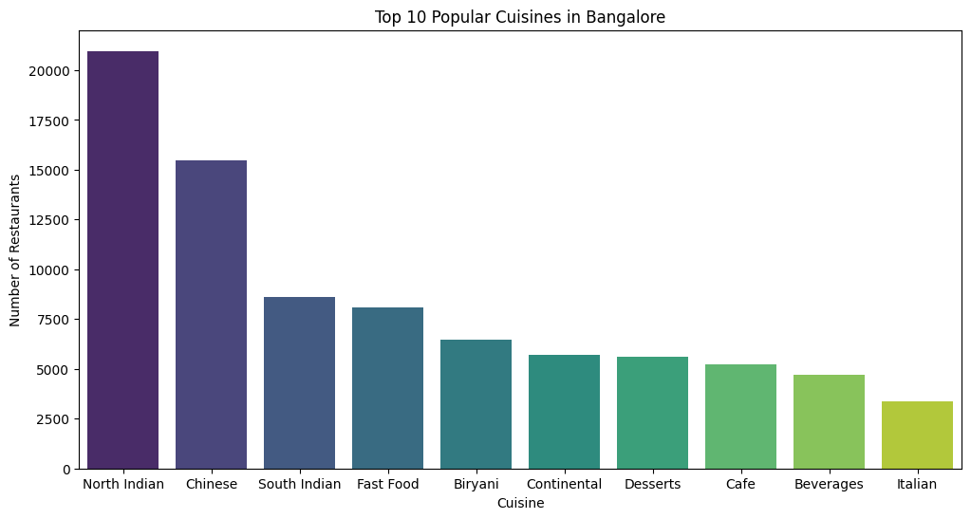
Which cuisines are most favored in Bangalore?

Slide 6
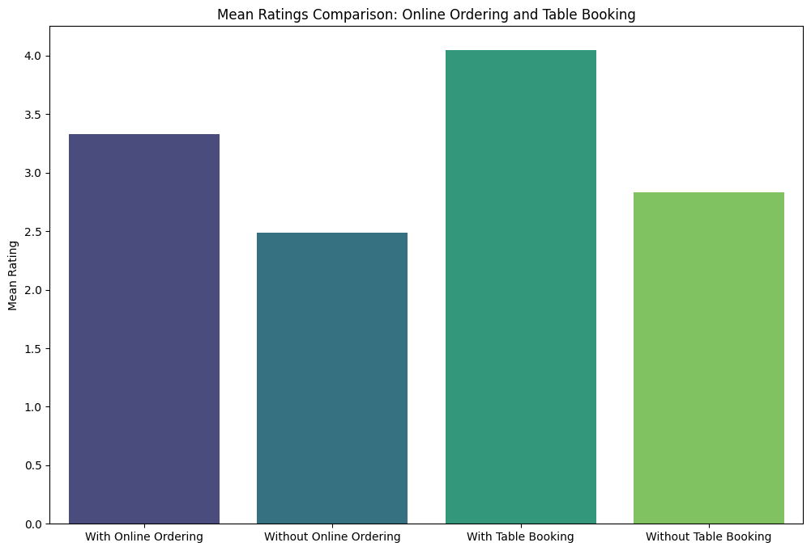
Is there a connection between online ordering, table booking and higher restaurant ratings?

Slide 7
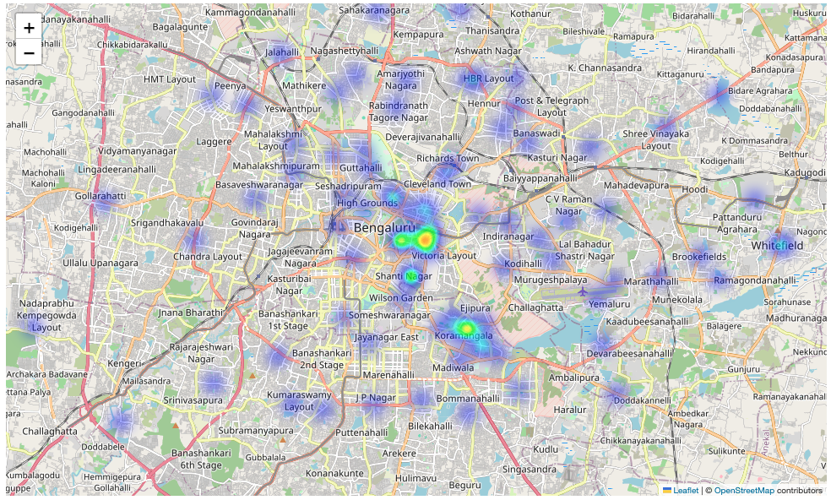
Geographical Analysis of the Restaurants

Slide 8
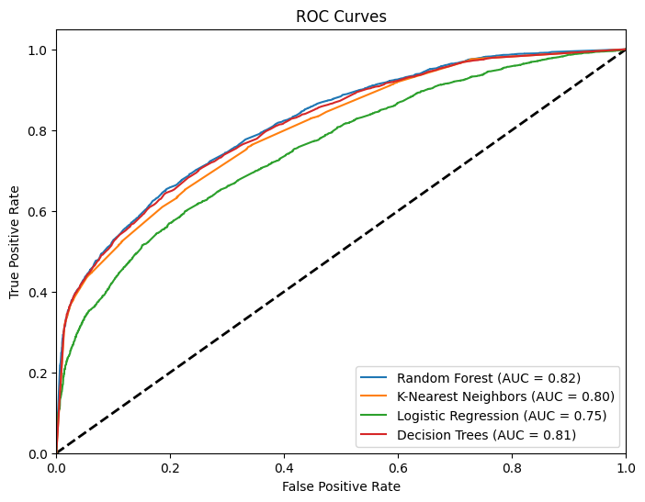
Predictive Model Overview

Slide 9
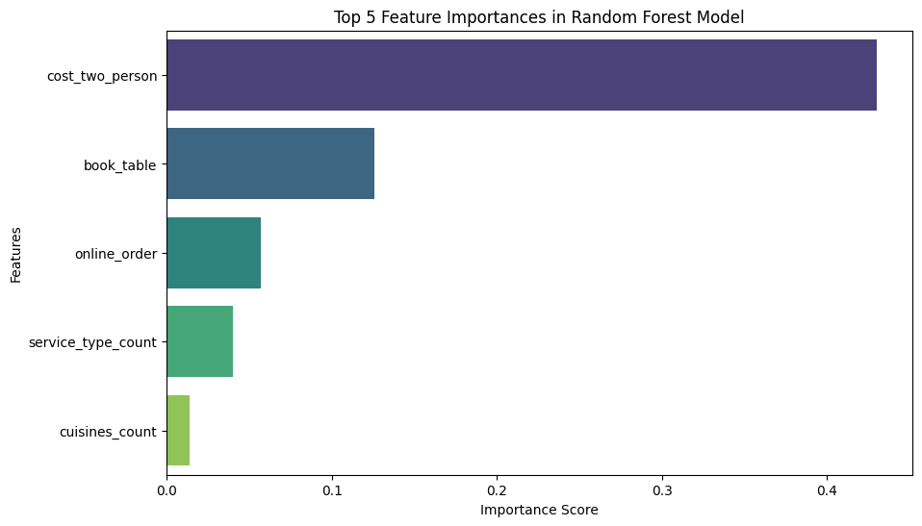
Key Predictors of Restaurant Success in Zomato Ratings

Slide 10
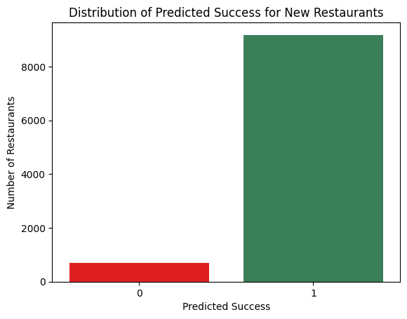
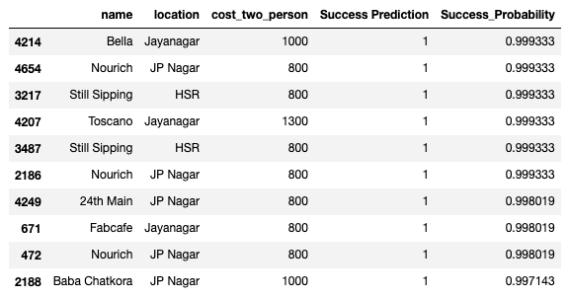
Forecasting New Entrants' Success on Zomato

Slide 11
Conclusion and Future Directions
Significance of Findings: Proven predictive power for Zomato restaurant success.
Future Expansions: Improving accuracy with more data, expanding to new cities.
Practical Applications: Helping restaurant owners enhance service and operations.

Slide 12
Thank You!

